Slide 1

Data Translation Challenge
COVID-19 & Effects on Retail Labor Market
Lorenzo Powell – solo project

Slide 2
COVID-19 and the Evolved Market
COVID-19 emerged in the US early 2020
first reports were right before the new year
By March
The CDC formally acknowledged the pandemic
The US calls for a nationwide state of emergency
States begin implementing lockdown protocols
Essential businesses were the only vendors to remain open for business
Some businesses begin taking advantage of e-commerce strategies during these early stages
Notes:
healthcare, grocery, take-out dining,

Slide 3
Retailers Woes
Pandemic mitigation lockdowns either eliminate or reduce store hours
Staffing shortages
Result of overhead management or business-model restructuring
Result of employee decision
Hour reduction
External factors (ie. Childcare, significant health risk/complications, etc.)
Undesirable attendance behavior (potentially with financial incentive)
Flight from workforce
External factors (see above)
Able to reap financial support benefits from offered public services
Notes:
the retail industry has seen some of the most hardship
in addition to reduced customer traffic
limits on total workplace occupancy volume means a tighter balance of staff/client ratio needed to stay afloat
store closures or reduced hours
in conjunctino with
Staffing among the biggest hurdles as they must manage cost but should also aim to help financial welbeing of employees

Slide 4
Investigation Foci
What insights do employment trends offer about the health of the retail industry? *
How has retail fared relative to other industries? *
Who is working and earning money? What changes can be observed and predicted?

Slide 5
IPUMS_CPS Data
Dummy variables relating to the unemployment & other labor-force status, retail industry, and pre/post COVID-19 pandemic presence
I’ve restricted observations to 17 to 64 years old
This should should most working age adults
Medicare benefits start at 65
Data is grouped by year and employment status
not the created dummy-variables
Notes:
using the current populaiton survey i was able to create dummy variables pertaining to employment status, industy, and pandemic presenc

Slide 6
Pandemic Retail Staffing
Not In Labor Force category is not included in analysis
The first 2 regression models included below regress
Unemployment on the presence of the pandemic
Unemployment on the presence of the pandemic controlling for age
Allows age cohorts to be compared pre & post for pandemic labor
It indicates a positive association between the variables for:
Pandemic presence
Employment in the retail industry.
The first model indicates that
The pandemic is associated with a 0.0047 unit change in unemployment
adding age as a control the pandemic’s presence is associated with a -0.0007 unit change in age of the unemployed respondents
Regression effects are not as impressive as expected
Notes:
Excluded participants that selected NILF as the reasoning would have brough about noise if not appropriately managed.
Pre COVID employees = 204,550
Post COVID employees = 171,235

Slide 7
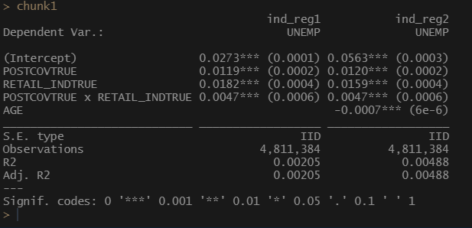
Regression Chunk 1
Notes:
a correction for the previous slide is that the relationship is positively correlated to unemployment rather than employment
presence of the pandemic is associated with a 0.0047 unit iincreased likelihood for unemployment
controlling for age changes very little

Slide 8
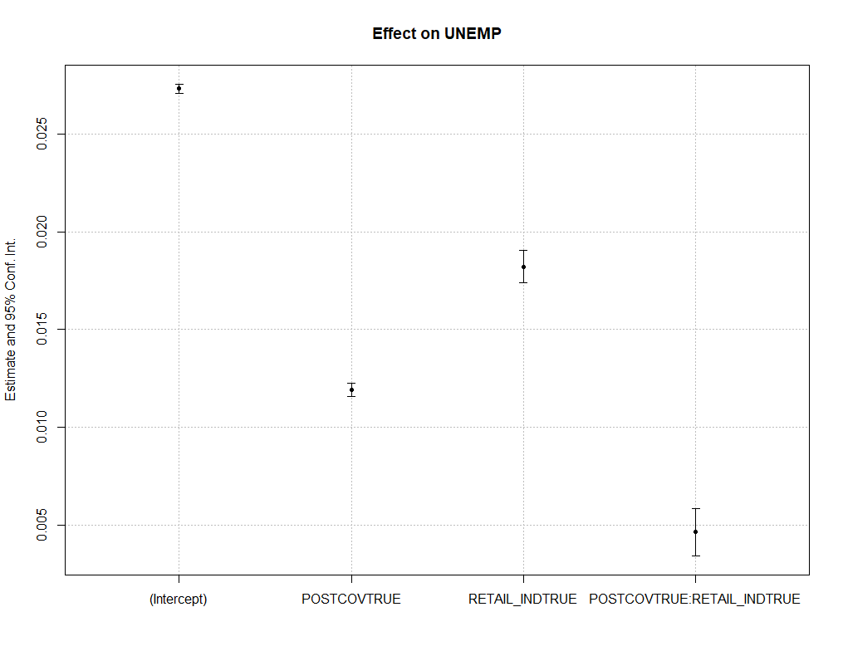
Confidence Interval Plot

Slide 9
Retail Hours and Absenteeism
More optimal models use regression discontinuity
Cutoff of the pandemic start year, 2020
Investigate average retail employee hours and overall unemployment before and after 2020
Both dependent metrics demonstrate a positive correlation at the 1% significance level
After 2020, a 1 unit change in year is associated with:
a 0.0204 unit change in unemployment
a -218.9 unit change in average weekly hours worked
The third regression includes controls for both age and FTE/PTE employment status to the prior model
Retail industry employees are likely to work 95.58 units less after 2020
Supports the assumption that retailers are disproportionately impacted by staffing following the pandemic onset

Slide 10
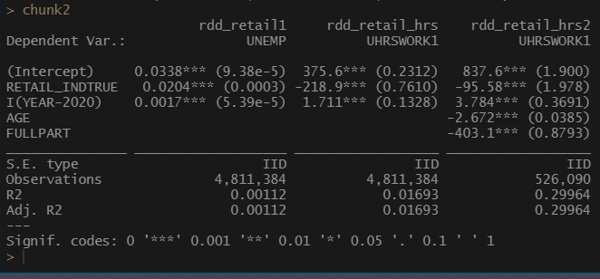
Regression Chunk 2

Slide 11

Education and Unemployment
For respondents with degrees, there is a 0.0001 unit increase in unemployment in the same year of earning that degree when controlling for age
Not a substantial change
Likely because of the graduation rate being
Age is negatively associated with unemployment
A -0.0007 unit change in age while controlling for recency of degree
Unfortunately, my regression design left only 279,139 observations after excluding NA values.
A T-test analysis should be considered under the setting of more time

Slide 12
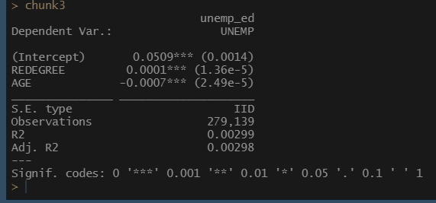
Regression Chunk 3

Slide 13
Retail Employee Absenteeism and Hours Worked
The last cluster investigates retail employee absenteeism and average weekly hours worked in the setting of the pandemic.
First regression model can be understood as a potential incentive for staff to continue unreliable behavior
Without consideration of the pandemic staff payment if absent is associated with a 1.37 unit increase staff absenteeism
The second model regresses average hours worked on payment for absenteeism additionally controls for an employees FTE/PTE status and age
While controlling for FTE/PTE status and age, payment for absenteeism associated with a -48.57 unit change in hours worked at the 1% significance level
Paid absenteeism is strongly correlated with reduced workplace attendance
The last model regresses average weekly hours worked on the pandemics presence in the retail industry
The joint effect was not statistically significant
Controlling for retail industry employment, the presence of the pandemic is associated with a 14.09 unit increase in average hours worked
controlling for the pandemic, retail industry employees see a -219.9 unit decrease in working hours

Slide 14
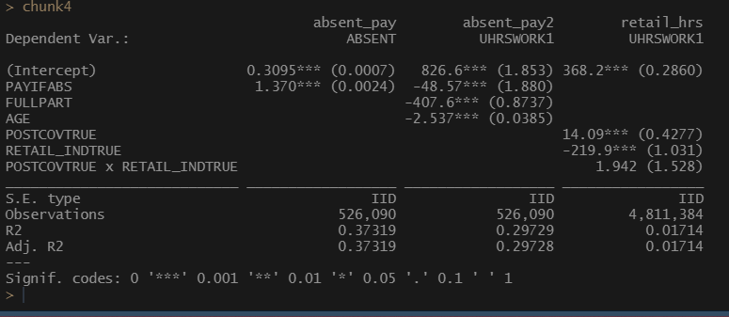
Regression Chunk 4

Slide 15
General Takeaways
The pandemic has had greater negative impact in retail as compared to other industries
Employee Hours
Staffing
Employee age was as impactful as expected
Nor education

Slide 16
Shortcomings
Recommended Regression model was not used
By own negligence
Skill deficiency
Visualizations
Data/variable groupings
‘Not In Labor Force’ confounds
Education variable design
‘Not In Retail’ industry design
Include more industry groups

